Slide 1
No. 21

Slide 2
Q. 100 surnames were randomly picked up from a local telephone directory and a
frequency distribution of the number of letters in the English alphabets in the
surnames was found as follows :
Number of letters
Number of surnames
1 – 4
6
4 – 6
30
6 – 8
44
8 – 12
16
12 – 20
4
(i) Draw a histogram to depict the given information.
(ii) Write the class interval in which the maximum number of surnames lie.
(i) In the given frequency distribution, we see that the class-sizes are different.
Soln.
Hence, we calculate the adjusted frequency for each class by using the formula :
Minimum class-size
Adjusted frequency for a class
=
×
its frequency
Class - size of this class
In this problem, the minimum class-size
=
6
-
4
=
2
We thus obtain the following table of the adjusted frequency.

Slide 3
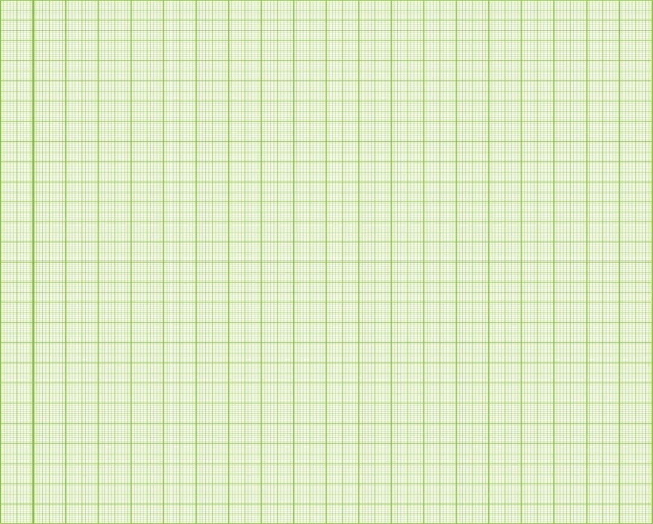
minimum class-size
=
6
-
4
=
2
y
Scale 1cm = 5units
Number
of
letters
Freq.
Adj. freq.
Min. class-size
Adj. freq.
=
×
size of this class
its freq.
2
Min. class-size
1 – 4
6
Adj. freq.
=
×
×
6
=
4
size of this class
its freq.
3
Number of Leaves
4 – 6
30
2
×
30
=
30
2
45
40
6 – 8
44
2
×
44
=
44
35
2
30
25
2
20
8 – 12
16
×
16
=
8
15
4
10
2
5
X
12 – 20
4
×
4
=
1
8
0
2
4
6
8
10
12
14
16
18
20
Length (in mm)

Slide 4
No. 22

Slide 5
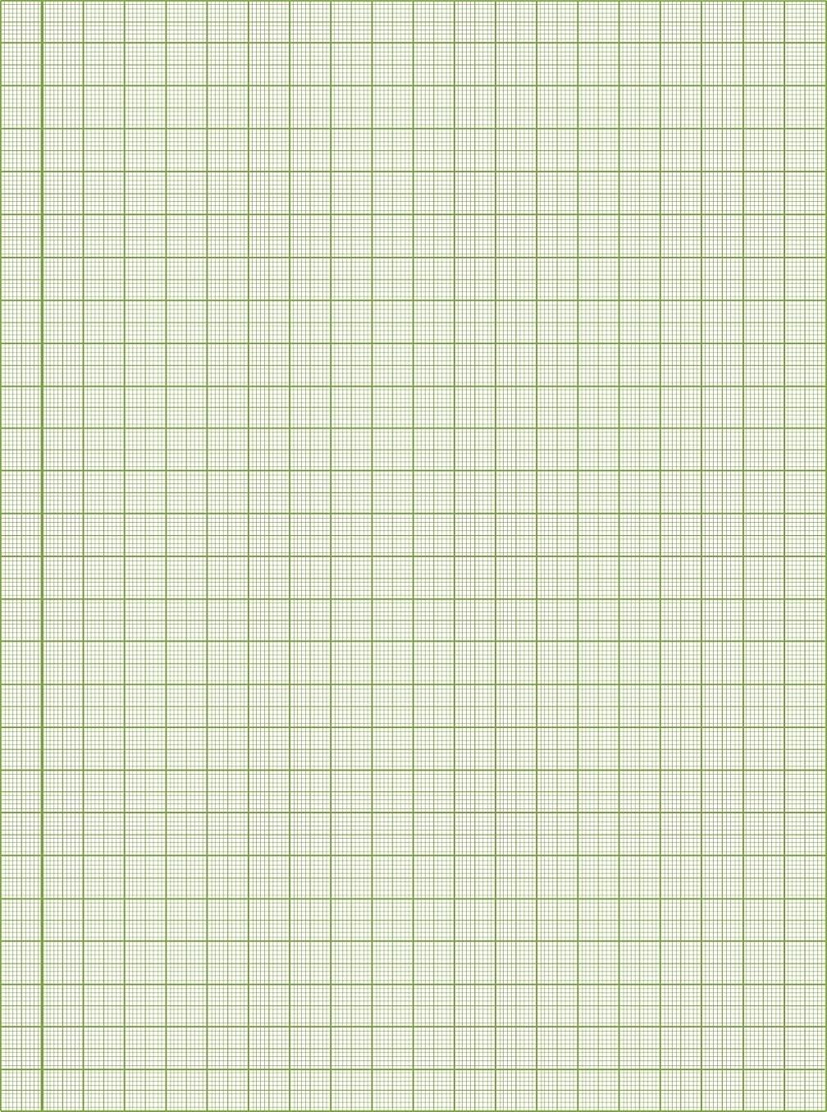
Q.] A random survey of the number of children of various age groups playing in a
park was found as follows : Draw Histogram.
Y
Scale :
On X axis:1 cm = 1 year
Lets represent this data by Histogram
On Y axis:1 cm = 1 child
In the given frequency distribution,
we see that the class-sizes are different.
Age (in years)
Frequency
Adj. freq.
Hence, we calculate the adjusted frequency
for each class by using the formula :
Minimum class-size
=
2
–
1
=
1
1 – 2
5
1
×
1
5
=
5
1
Adj. freq. for a class
Min. class-size
×
its frequency
×
=
2 – 3
3
1
3
=
3
Size of this class
1
×
3 – 5
6
2
6
=
3
Mark frequencies on
Y-axis
1
×
5 – 7
12
2
12
=
6
9
1
×
7 – 10
3
9
=
3
1
6
10 – 15
10
×
5
10
=
2
5
1
Frequency
4
×
4
15 – 17
2
4
=
2
Mark class limits on
X-axis
3
2
1
X
X’
0
1
2
3
4
5
6
7
8
9
10
11
12
13
14
15
16
17
Y’
Age (in years)

Slide 6
No. 23

Slide 7
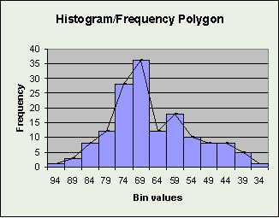
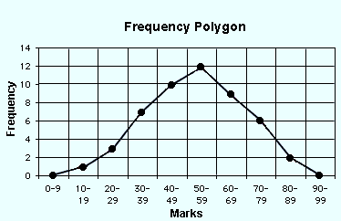
Frequency Polygon

Slide 8
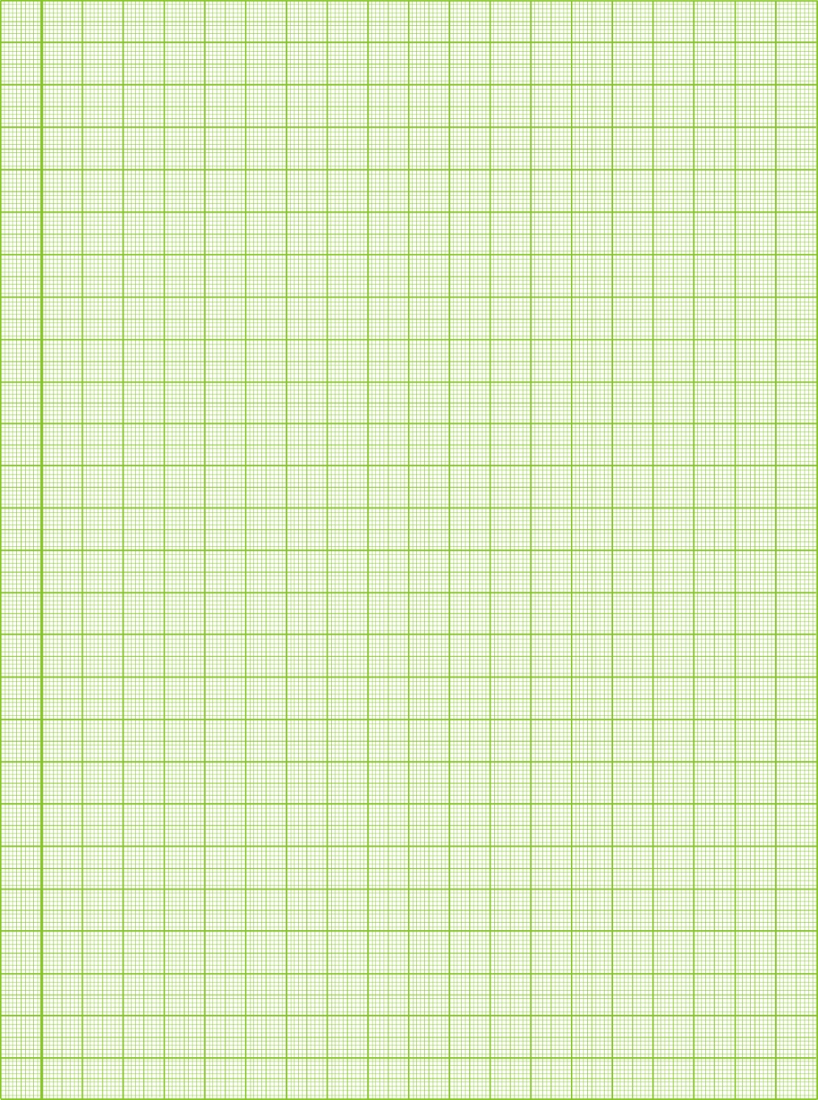
frequency polygon
Q. Draw frequency polygon and for the following frequency
distribution.
Scale :
Y
On X axis:2 cm = 5 units
To draw frequency polygon, frequency of first and last class must be zero
Class interval | 5 – 10 | 10 – 15 | 15 – 20 | 20 – 25 | 25 – 30
Frequency | 20 | 30 | 50 | 40 | 10
On Y axis:1 cm = 5 units
Since we have 20 cms on
Y-axis, we will consider scale as 1 cm = 5 units
What is the highest frequency?
50
Mark frequencies on
Y-axis
Scale is always gap in cm equal to difference with units
Sol:
0 + 5
= 2.5
2
50
(17.5, 50)
Class interval
Class mark
Frequency
45
40
The co-ordinates of the point is
( midpoint, frequency)
(22.5, 40)
0 – 5
2.5
0
Lets find class marks i.e. x co-ordinates
35
(12.5, 30)
Frequency
5 – 10
7.5
20
30
We plot the points on the graph paper
25
(7.5, 20)
Mark class limits on
X-axis
10 – 15
12.5
30
20
Lets introduce a class before first class
15
Now introduce a class after last class
15 – 20
17.5
50
10
(27.5, 10)
20 – 25
22.5
5
40
(2.5, 0)
(32.5, 0)
X’
0
5
10
15
20
25
30
35
X
25 – 30
27.5
10
Y’
Class interval
30 – 35
32.5
0

Slide 9
No. 24

Slide 10
Q. The following two table gives the distribution of students of two sections according
to the marks obtained by them :
Section A
Section B
Marks
Frequency
Marks
Frequency
0 – 10
3
0 – 10
5
10 – 20
19
10 – 20
19
20 – 30
12
20 – 30
15
30 – 40
7
30 – 40
10
40 – 50
9
40 – 50
1
Represent the marks of the students of both the
sections on the same graph by two frequency polygons

Slide 11
Class interval
Class
mark
Sect. A
Sect. B
Scale :
–10 – 0
-5
0
0
Y
On X axis:2 cm = 10 units
0 – 10
5
3
5
On Y axis:1 cm = 2 units
Since we have 20 cms on
Y-axis, we will consider scale as 1 cm = 2 units
Let us find the class marks which are x- Co-ordinates
What is the highest frequency?
Lets introduce a class before first class
19
10 – 20
15
9
19
-10 + 0
= -5
20 – 30
25
15
Scale is always gap in cm equal to difference with units
2
17
Mark frequencies on
Y-axis
35
Now introduce a class after last class
30 – 40
12
10
20
18
(15, 19)
40 – 50
45
9
1
16
14
(25, 15)
50 – 60
55
0
0
Frequency
(25, 17)
12
(35, 12)
10
(35, 10)
8
Mark class limits on
X-axis
6
(5, 5)
(15, 9)
(45, 9)
To draw frequency polygon, frequency of first and last class must be zero
4
2
(-5, 0)
(5, 3)
(45, 1)
(55, 0)
-10
0
10
20
30
40
50
60
X
Y’
Class interval (Marks)

Slide 12
No. 25

Slide 13
Q. The runs scored by two teams A and B on the first 60 balls in a cricket match are
given below :
Number of balls
1 - 6
7 - 12
13-18
19 - 24
25 - 30
31 - 36
37 - 42
43 - 48
49 - 54
55 - 60
Team A
2
1
8
Divide the difference value by 2
9
4
5
6
10
6
2
Team B
Subtract the value from the lower limit and add it to the upper limit.
5
6
2
10
5
6
3
4
8
10
1 – 0 = 1
Represent the data of both the teams on the same graph by frequency polygons
Sol.
Number of balls
Continuous classes
Team A
Team B
1 ÷ 2 = 0.5
-5 – 0
Find Difference between upper limit & lower limit of next class.
– 5 – 0.5 = – 5.5
– 5.5 – 0.5
0
0
1 – 6
0.5 – 6.5
2
5
– 0 + 0.5 = 0.5
7 – 12
6.5 – 12.5
1
6
Lets introduce a class before first class
13 – 18
12.5 – 18.5
8
2
19 – 24
18.5 – 24.5
9
10
Now introduce a class after last class
25 – 30
24.5 – 30.5
4
5
31 – 36
30.5 – 36.5
5
6
Let us make the classes continuous
37 – 42
36.5 – 42.5
6
3
43 – 48
42.5 – 48.5
10
4
49 – 54
48.5 – 54.5
6
8
55 – 60
54.5 – 60.5
2
10
61 – 66
60.5 – 66.5
0
0

Slide 14
Number of balls
Continuous classes
Team A
Team B
Y
On X axis:1 cm = 6 Balls
Lets Draw frequency polygon for team B
12
On Y axis:1 cm = 1 Run
-5 – 0
– 5.5 – 0.5
0
0
11
1 – 6
0.5 – 6.5
2
5
10
Mark class limits on
X-axis
7 – 12
6.5 – 12.5
1
6
Since we have 20 cms on
Y-axis, we will consider scale as 1 cm = 1 run
10
13 – 18
12.5 – 18.5
8
2
9
What is the highest frequency?
Mark frequencies on
Y-axis
19 – 24
18.5 – 24.5
9
10
8
25 – 30
24.5 – 30.5
4
5
7
31 – 36
30.5 – 36.5
5
6
37 – 42
36.5 – 42.5
6
3
6
Number of Runs
43 – 48
42.5 – 48.5
10
4
5
49 – 54
48.5 – 54.5
6
8
55 – 60
54.5 – 60.5
2
10
4
61 – 66
60.5 – 66.5
0
0
3
2
1
0.5
-5.5
6.5
12.5
18.5
24.5
30.5
36.5
42.5
48.5
54.5
60.5
66.5
X’
X
Y’
Number of balls

Slide 15
Thank You

